Slide 1
Senior Meeting!
January 18, 2019
If you haven’t already signed up…
Text @ganders19 to 81010
If you use Verizon, you must get the App to continue receiving messages!

Slide 2
SENIOR INFO!
Passing Grades (Every Class)
+
Great Attendance (Every Day)
_______________
Credits Earned = Graduate on Time

Slide 3
SENIOR INFO!
PROM- April 26, 2019 @ San Luis Resort
Theme: “The Roaring 20’s”
Pricing goal is $40/ticket
Seniors with tickets are able to leave campus early on prom day.
If you do not attend school, you do not attend prom.
Must be passing classes
No Edgenuity Classes Outstanding

Slide 4
SENIOR INFO!
PROM- April 26, 2019 @ San Luis Resort
Expenses must be covered largely by fundraisers:
1. Fish Fry – Success
2. Chocolate Sales – $$$ by March 1st
Publish Prom Ticket Prices in March based on total sales.

Slide 5
SENIOR INFO!
Other Dates
Senior Panoramic- February 19, 2019
  9am in parking lot by water
Senior Fun Day- April 29, 2019

Slide 6
SENIOR INFO!
Edgenuity/Attendance Recovery
Saturdays: 8am-Noon
Jan. 26th
Feb. 2nd
Feb. 16th
Mar. 2nd

Slide 7

SENIOR INFO!
GRADUATION!
  June 1, 2019
  Fertitta Center (UH Campus)

Slide 8
Acceptances & Scholarships
If you’ve been accepted to a college, military branch, or technical program bring your acceptance letter to room 202, we want to announce you & add your picture to the wall!
If you’ve received a scholarship or grant offer, even if you don’t plan on using it, bring the letter and amount to room 202!

Slide 9

GCCISD Local Scholarships
Class of 2019

Slide 10

Application Process
Local Scholarship Application
School Community Involvement List
Personal Statement
Special Application (If needed)
Folder

Slide 11

Request Forms
Transcripts (form required)
-received today
Letter of Recommendation

Slide 12
Deadlines
Order transcripts January 22nd-February 15th place request in box in main office.
Transcripts will be available during all lunches on Thursday, Feb. 28th
All scholarship packets due: Friday, March 1st by 3:00 p.m. in the College and Career Lab (Room #202)

Slide 13
Important
Be Neat
Prepare Early
Double Check
Ask for help
The submission list must be turned in with your scholarship applications. It must be placed on the top of your alphabetically organized application folders and a rubber band should be placed around the entire set of folders.
Scholarship Name
Your Name
Your Street
Your City and Zip
Your School

Slide 14
Naviance
Every GCCISD student has their own Naviance account. Naviance is a College and Career Readiness Program.
Signing in is simple. Just type…
www.Naviance.com
User Name = Student ID Number
Password = Student date of birth 02271994
Click Colleges Tab

Slide 15
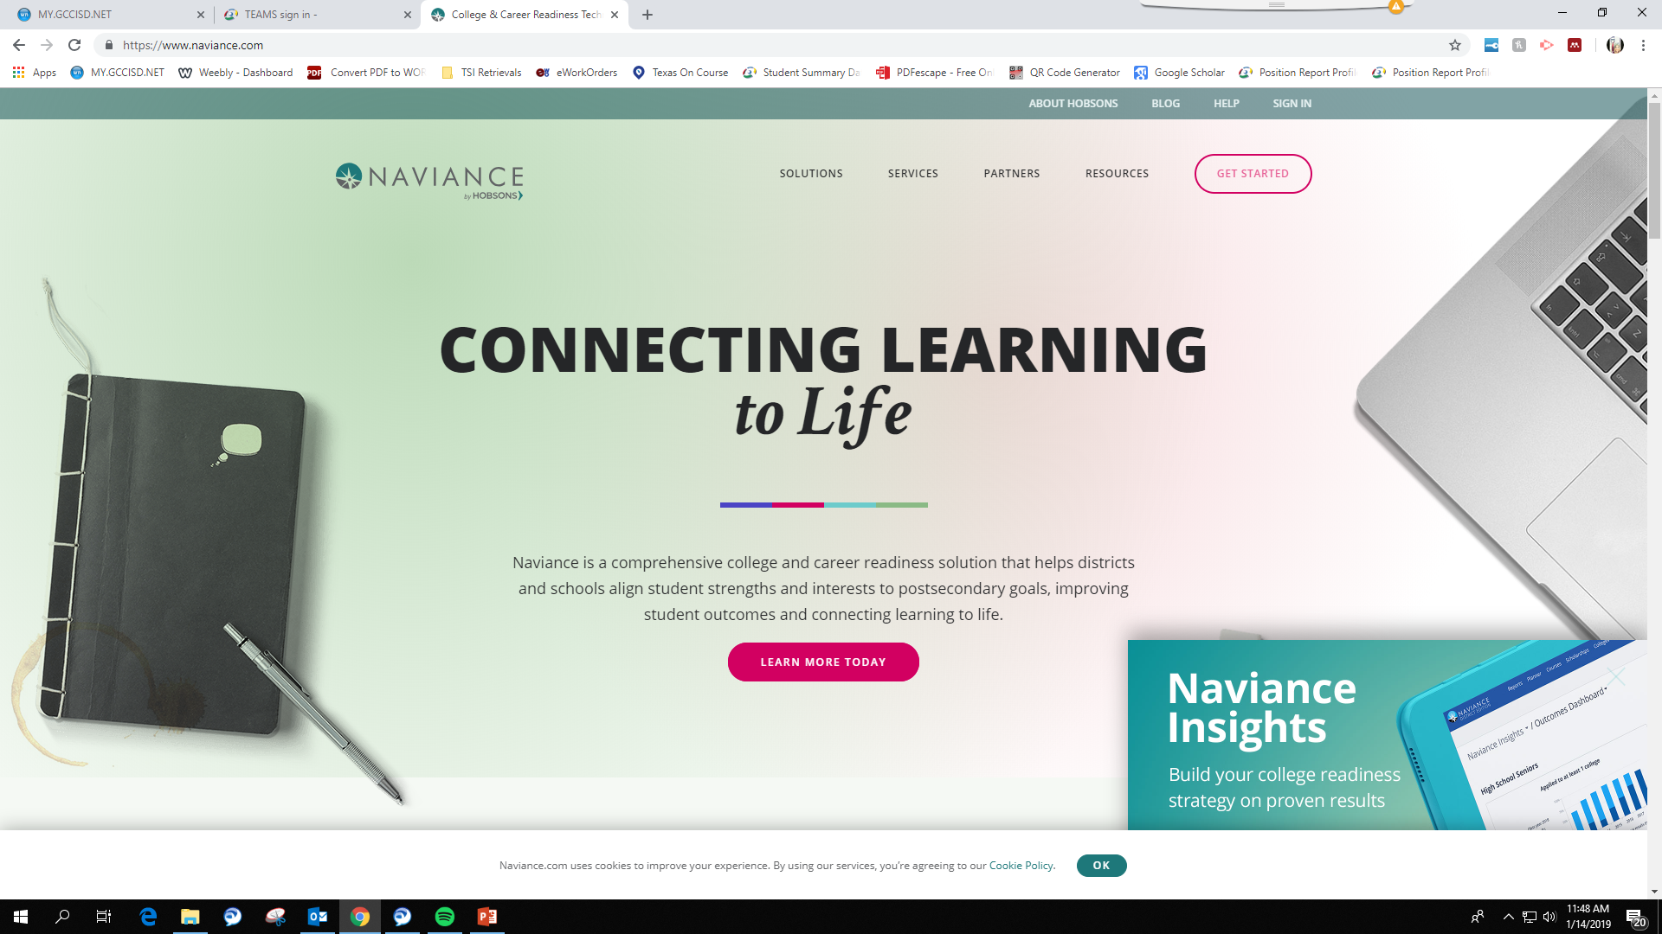
Naviance

Slide 16
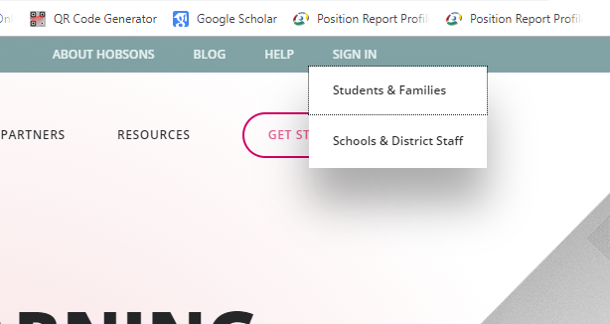
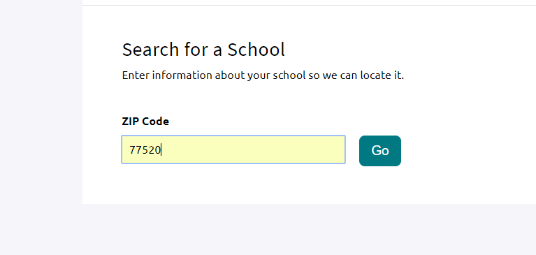
Naviance
1
Log in as a student
using your ID# as your username
And 8-digit birthdate as your password
Example:
Username: 01234
Password: 01012001
2
Enter our zip then select REL High School

Slide 17
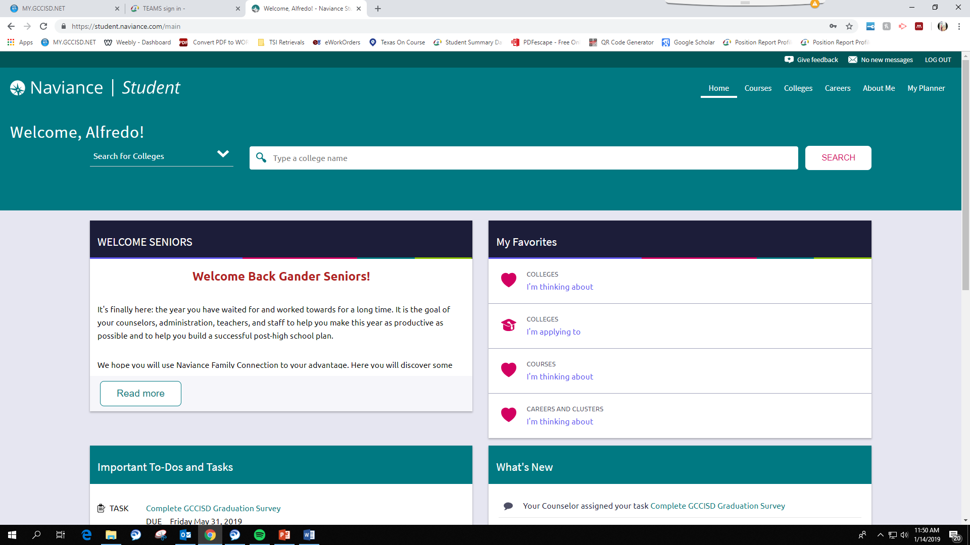
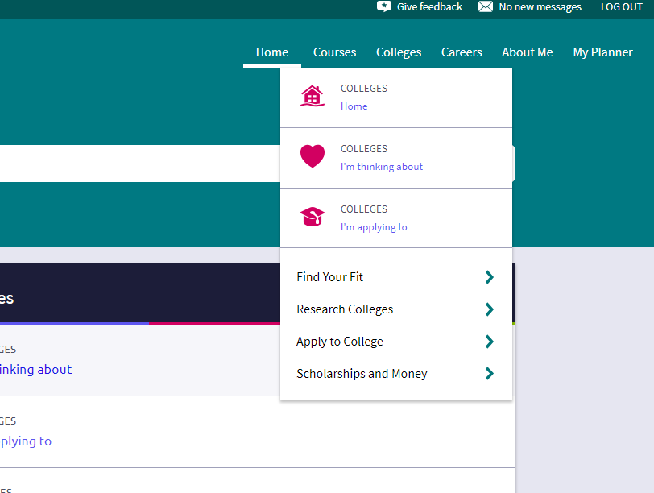
Naviance
3
Once Logged in, choose “Colleges” from the top right.
4
Next, choose
“scholarships and Money”

Slide 18
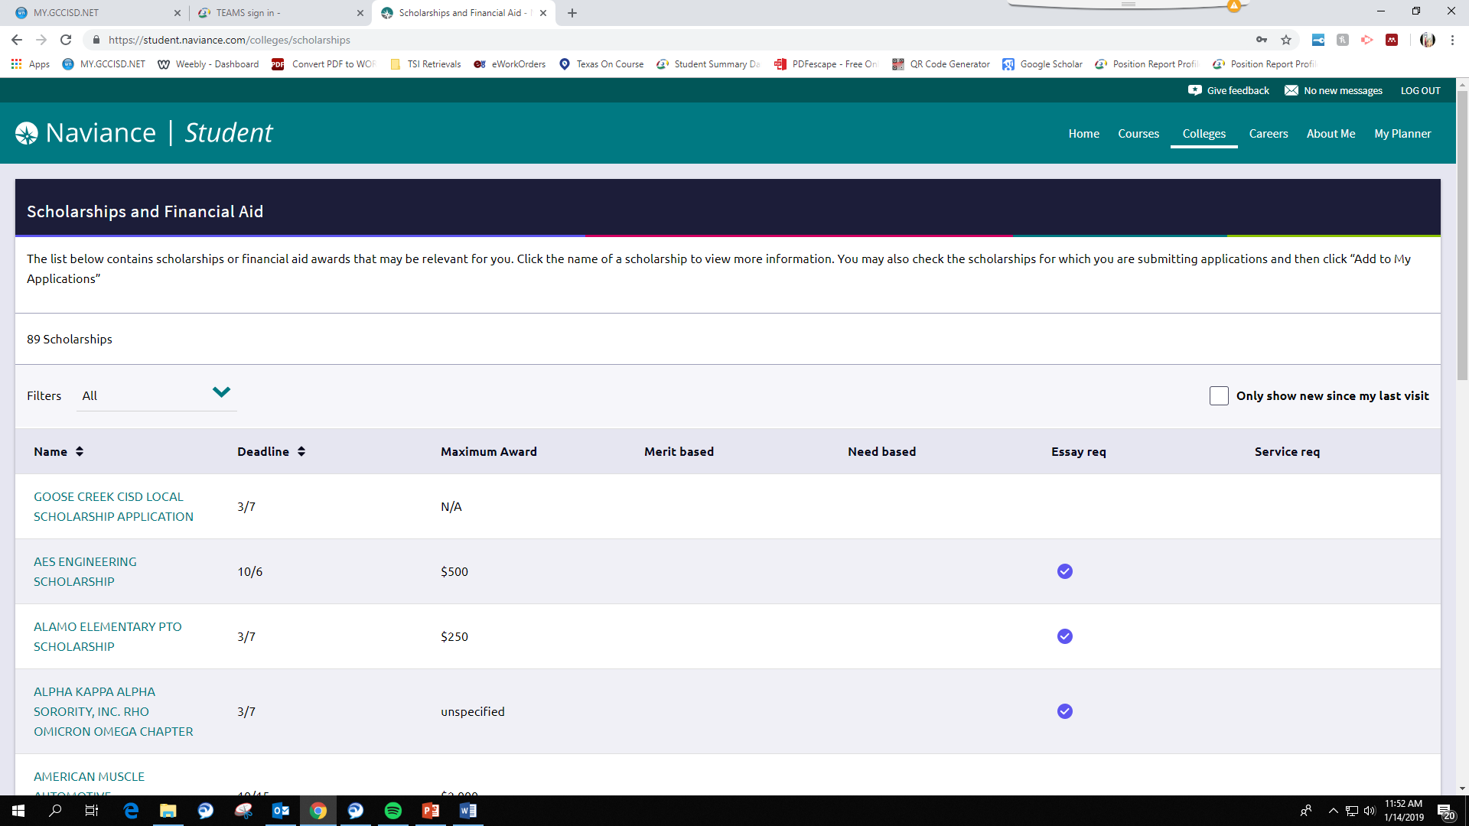
Naviance
5
You will then be directed to a page with all the local scholarships as well as the district scholarship application
District Application (you will need one for each different scholarship)
Individual scholarships and forms

Slide 19
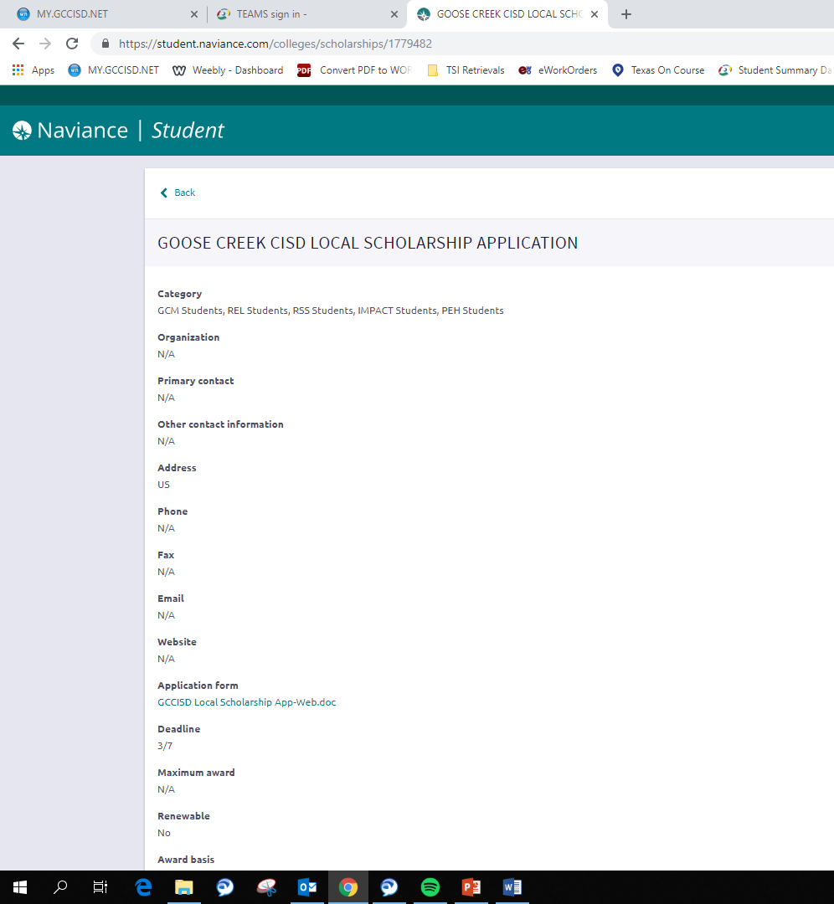
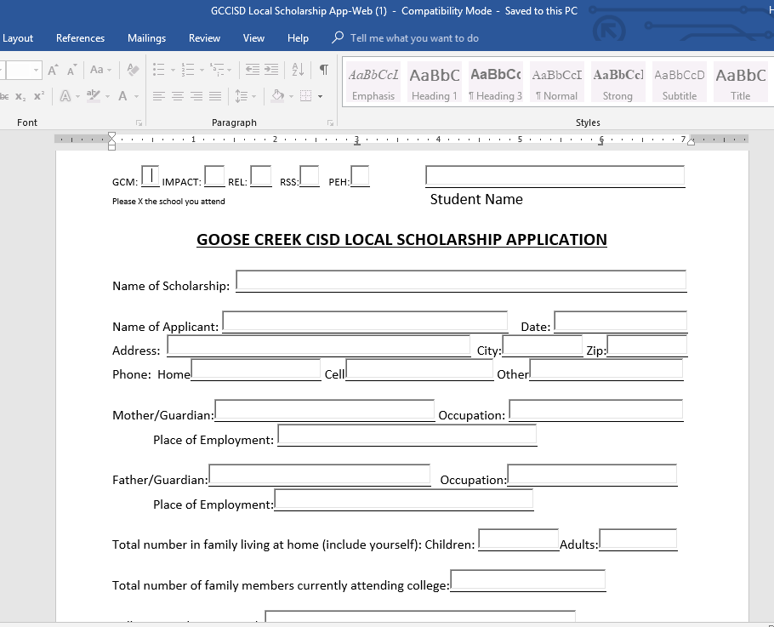
Naviance
6
District Application
(you will need one for each different scholarship)

Slide 20

Don’t Forget
All this information and additional applications and special applications are available in the College and Career Corner or online.
RELcounseling.weebly.com

Slide 21
Don’t Forget
Good Luck and remember:
  All scholarship packets due on or before March 1st at 3:00 p.m.

